Slide 1





OOP Project Presentation
2D Featureful GUI-Based
Brick-Breaker Game
Hrithik Chugh

Slide 2

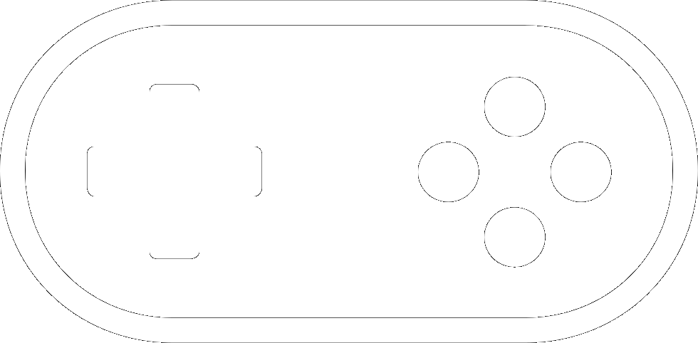
Approaches to the perception of difficulty:
Linear
Level-based

Slide 3
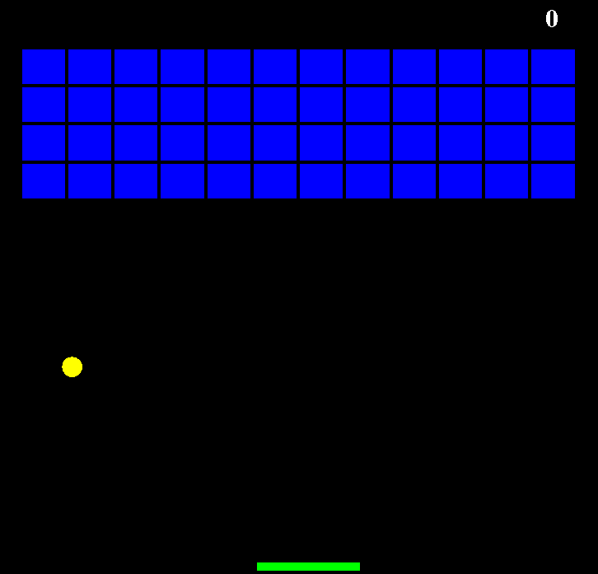
Featureful
Basic Gameplay.
Levels.
Specials: Random destructions cause:
As promised:
Ball Speed change.
Fire ball (destruction of the peripheral bricks).
Pass-through Ball.
Bar Size change.
Left-Right Bar direction interchange.
For repr. purposes only. Differs from our actual game.
Discarded:
Rotation of the gameplay area (Eq. of Circle).
Multiple Balls.
New additions:
Gun Bar.
Bar segmentation.
Bar height levels.
Permanent Bricks.
Invisible Bricks.
Unique:
Bar segmentation.
Bar height.
Invisible Bricks.
Excluded:
Magnet Bar.

Slide 4
Let the games begin!

Slide 5
A few of the Anomalies/complexities we faced & overcame:
Ball-Brick Collisions.
Ball-Bar Collisions.
Levels’ Implementations & Incorporations.
Features’ Implementations & Incorporations.

Slide 6
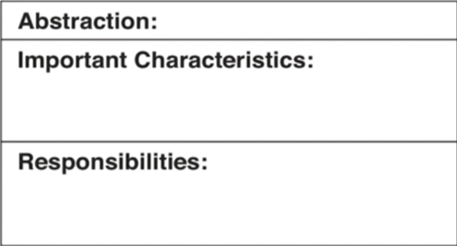

Abstractions:
Main
Database
CirRectOverlapCheck
JFrame
Gameplay as a component
Connection & Statement objects.
Username, Score, Highscore.
Centre of Circle (Ball), Opposite diagonal points of rectangles (Bar & Bricks).
Making of the basic structure JFrame and
addition of component Gameplay.
Stores the current score with the current username and returns the highest score.
Drawing/Generating the Bricks.
MapGenerator
Gameplay
Brick Dimensions, Map Dimensions, Levels.
Ball, Bricks & Bar Coordinate variables & score variable. Other game control variables, feature control variables as well.
Drawing/Generating/Degenerating the Bricks
according to the current level.
Handling key events for the bar.
Handling ball movement & collisions.
Handling Game frames.
Handling all features.
Handling levels and menu screens.
Handling

Slide 7
Some secondary yet profound facts:
We built this game from scratch. Yet it’s a small-scale project, we included a plethora of features.
We tested this game around at least 1000 times.
Total time taken to think and build this game is around approx at least = 10 * 24 hrs = 240 hrs.
Thank y’all for your time.

